Slide 1
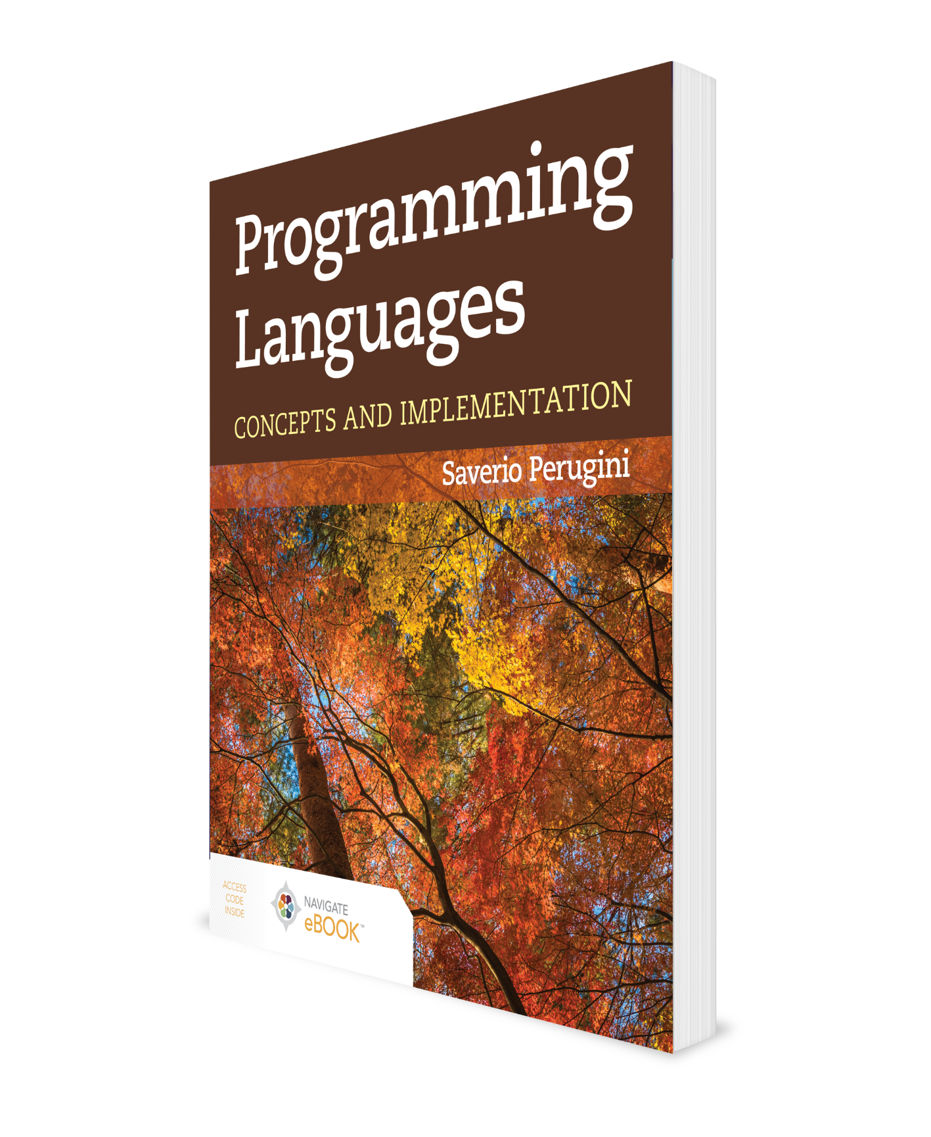
Data Abstraction
CHAPTER 9

Slide 2
Chapter 9: Type Systems and Data Abstraction
Reimplementing [familiar] algorithms and data structures in a significantly different language often is an aid to understanding of basic data structure and algorithm concepts.
—Jeffrey D. Ullman, Elements of ML Programming (1997)
Type systems support data abstraction and, in particular, the definition of user-defined data types that have the properties and behavior of primitive types.

Slide 3
Outline
9.1 Chapter Objectives
9.2 Aggregate Data Types
9.3 Inductive Data Types
9.4 Variant Records
9.5 Abstract Syntax
9.6 Abstract-Syntax Tree for Camille
9.7 Data Abstraction
9.8 Case Study: Environments
9.9 ML and Haskell: Summaries, Comparison, Applications, and Analysis
9.10 Thematic Takeaways

Slide 4
9.1 Chapter Objectives
Introduce aggregate data types (e.g., arrays, records, unions) and type systems supporting their construction in a variety of programming languages.
Introduce inductive data types—an aggregate data type that refers to itself—and variant records—a data type useful as a node in a tree representing a computer program.
Introduce abstract syntax and its role in a representing a computer program.
Describe the design, implementation, and manipulation of efficacious and efficient data structures representing computer programs.
Explore the conception and use of a data structure as an interface, implementation, and application, which render it an abstract data type.
Recognize and use a closure representation of a data structure.
Describe the design and implementation of data structures for language environments using a variety of representations.

Slide 5
Outline
9.1 Chapter Objectives
9.2 Aggregate Data Types
9.3 Inductive Data Types
9.4 Variant Records
9.5 Abstract Syntax
9.6 Abstract-Syntax Tree for Camille
9.7 Data Abstraction
9.8 Case Study: Environments
9.9 ML and Haskell: Summaries, Comparison, Applications, and Analysis
9.10 Thematic Takeaways

Slide 6
9.2 Aggregate Data Types
9.2.1 Arrays
9.2.2 Records
9.2.3 Undiscriminated Unions
9.2.4 Discriminated Unions

Slide 7
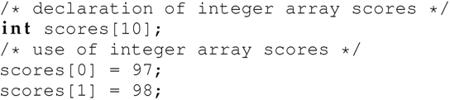
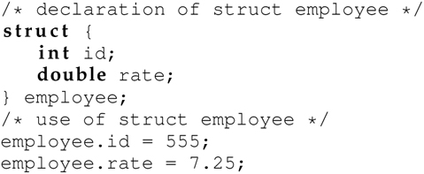
9.2 Aggregate Data Types: Arrays and Records
An array is an aggregate data type indexed by integers:
A record (also referred to as a struct) is an aggregate data type indexed by strings called field names:

Slide 8
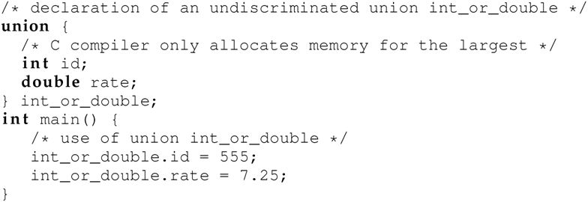
9.2.3 Undiscriminated Unions
An undiscriminated union is an aggregate data type that can only store a value of one of multiple types (i.e., a union of multiple types):

Slide 9
9.2.4 Discriminated Unions
A discriminated union is a record containing a union as one field and a flag as the other field.
The flag indicates the type of the value currently stored in the union.

Slide 10
Outline
9.1 Chapter Objectives
9.2 Aggregate Data Types
9.3 Inductive Data Types
9.4 Variant Records
9.5 Abstract Syntax
9.6 Abstract-Syntax Tree for Camille
9.7 Data Abstraction
9.8 Case Study: Environments
9.9 ML and Haskell: Summaries, Comparison, Applications, and Analysis
9.10 Thematic Takeaways

Slide 11
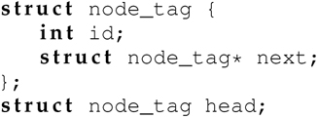
9.3 Inductive Data Types
An inductive data type is an aggregate data type that refers to itself.
The type being defined is one of the constituent types of the type being defined.
A node in a singly linked list is a classical example of an inductive data type.
The node contains some value and a pointer to the next node, which is also of the same node type:

Slide 12
Outline
9.1 Chapter Objectives
9.2 Aggregate Data Types
9.3 Inductive Data Types
9.4 Variant Records
9.5 Abstract Syntax
9.6 Abstract-Syntax Tree for Camille
9.7 Data Abstraction
9.8 Case Study: Environments
9.9 ML and Haskell: Summaries, Comparison, Applications, and Analysis
9.10 Thematic Takeaways

Slide 13
9.4 Variant Records
A variant record is an aggregate data type that is a union of records (i.e., a union of structs).
It can hold any one of a variety of records.
Each constituent record type is called a variant of the union type.
Variant records can also be inductive.

Slide 14
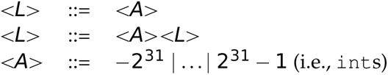
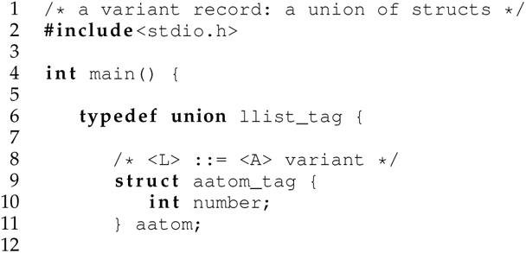
Variant Record Example
Consider the following EBNF definition of a list:

Slide 15
9.4.1 Variant Records in Haskell
Type systems support data abstraction and, in particular, the definition of user-defined data types that have the properties and behavior of primitive types.
A type system of a programming language includes the mechanism for creating new data types from existing types.
ML and Haskell each have a powerful type system.

Slide 16
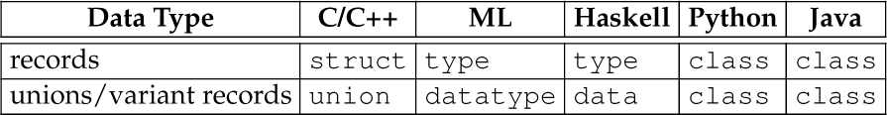
Table 9.1 Support for C/C++ Style structs and unions in ML, Haskell, Python, and Java

Slide 17
9.4.2 Variant Records in Scheme: (define-datatype ...) and (cases ...)
Unlike ML and Haskell, Scheme does not have built-in support for defining and manipulating variant records, so we need a tool for these tasks in Scheme.
The (define-datatype ...) and (cases ...) extensions to Racket Scheme created by Friedman, Wand, and Haynes (2001) provide support for constructing and deconstructing respectively, variant records in Scheme.

Slide 18
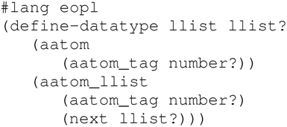
(define-datatype ...)
The(define-datatype ...) form defines variant records.
Syntax:
A new function called a constructor is automatically created for each variant to construct data values belonging to that variant.
Data types can be mutually-recursive (e.g., recall grammar for S-expressions)

Slide 19
A List of Integers (1 of 2)
This definition automatically creates a linked list variant record and an implementation of the following interface:
A unary function aatom, which creates an atom node
A binary function aatom_llist, which creates an atom list node
A binary predicate llist?

Slide 20

(cases ...)
The (cases ...) form, in the EOPL extension to Racket Scheme, provides support for decomposing and manipulating the constituent parts of a variant record created with the constructors automatically generated with the(define-datatype ...) form.
Syntax:
(cases ...) provides a convenient way to manipulate data types created with (define-datatype ...)
Can think of (cases ...) as pattern matching (values bound to symbols)

Slide 21
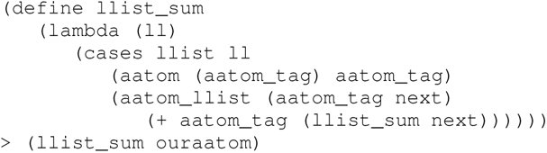
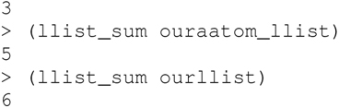
A List of Integers (2 of 2)
The following function accepts a value of type llist as an argument and manipulates its fields with the cases form to sum its nodes:

Slide 22
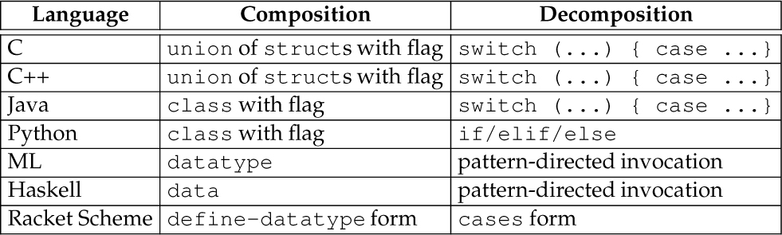
Table 9.2 Support for Composition (Definition) and Decomposition (Manipulation) of Variant Records in a Variety of Programming Languages

Slide 23
Outline
9.1 Chapter Objectives
9.2 Aggregate Data Types
9.3 Inductive Data Types
9.4 Variant Records
9.5 Abstract Syntax
9.6 Abstract-Syntax Tree for Camille
9.7 Data Abstraction
9.8 Case Study: Environments
9.9 ML and Haskell: Summaries, Comparison, Applications, and Analysis
9.10 Thematic Takeaways

Slide 24
9.5 Abstract Syntax (1 of 5)
Consider the string ((lambda (x) (f x)) (g y)) representing an expression in λ-calculus.
This program string is an external representation (i.e., it is external to the system processing it) and uses concrete syntax.
Programs in concrete syntax are not readily processable.

Slide 25
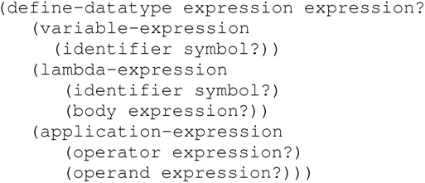
9.5 Abstract Syntax (2 of 5)
Notably, the preceding program is more manipulable and, thus, processable when represented using the following definition of an expression data type:

Slide 26
9.5 Abstract Syntax (3 of 5)
An abstract-syntax tree (AST) is similar to a parse tree, except that it uses abstract syntax or an internal representation (i.e., it is internal to the system processing it) rather than concrete syntax.
While the structure of a parse tree depicts how a sentence (in concrete syntax) conforms to a grammar:
the structure of an abstract-syntax tree illustrates how the sentence is represented internally,
typically with an inductive, variant record data type.
Figure 9.1 illustrates an AST for the λ-calculus expression.

Slide 27
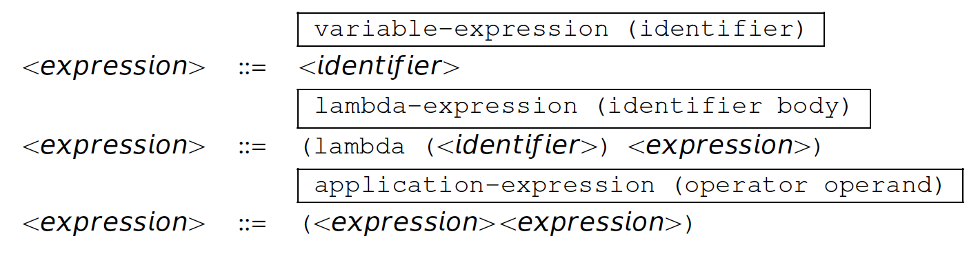
9.5 Abstract Syntax (4 of 5)
Abstract syntax is a representation of a program as a data structure—in this case, an inductive variant record.
Consider the following grammar for λ-calculus, which is annotated with variants of this expression inductive variant record data type above the right-hand side of each production rule:

Slide 28
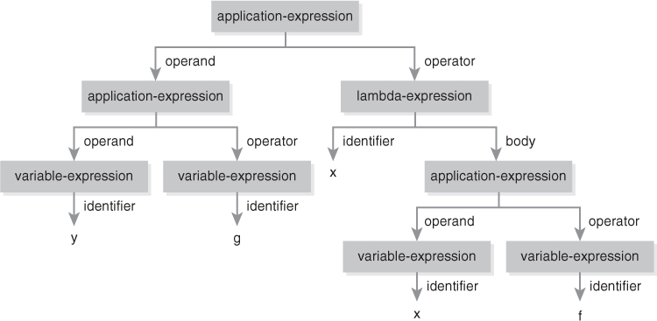
Figure 9.1 Abstract-Syntax Tree for ((lambda (x) (f x)) (g y))

Slide 29
9.5 Abstract Syntax (5 of 5)
Simple grammar for λ-calculus expressions revisited
Concrete vs. abstract syntax (external vs. internal representation)
expression datatype
One-to-one mapping between production rules and constructors

Slide 30
Inductive Data Types and Abstract Syntax Summary
Discriminated unions
Inductive data types (e.g., variant record: a union of structs)
define-datatype constructs inductive data types (specifically, variant records)
cases decomposes inductive data types
Concrete syntax vis-à-vis abstract syntax

Slide 31
Outline
9.1 Chapter Objectives
9.2 Aggregate Data Types
9.3 Inductive Data Types
9.4 Variant Records
9.5 Abstract Syntax
9.6 Abstract-Syntax Tree for Camille
9.7 Data Abstraction
9.8 Case Study: Environments
9.9 ML and Haskell: Summaries, Comparison, Applications, and Analysis
9.10 Thematic Takeaways

Slide 32
9.6 Abstract-Syntax Tree for Camille
A goal of Part II of this text is to establish an understanding of data abstraction techniques so we can harness them in our construction of environment-passing interpreters, for purposes of simplicity and efficiency, in Part III.

Slide 33
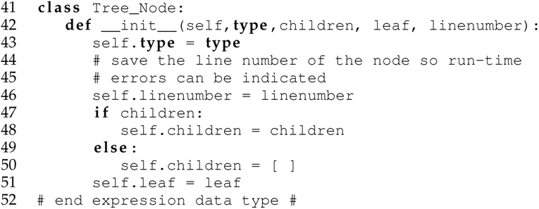
9.6.1 Camille Abstract-Syntax Tree Data Type: TreeNode
The following abstract-syntax tree data type TreeNode is used in the abstract-syntax trees of Camille programs for our Camille interpreters developed in Part III:

Slide 34
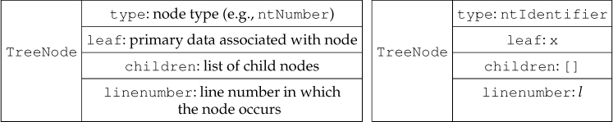
Figure 9.2 (left) Visual Representation of TreeNode Python class. (right) A Value of Type TreeNode for an Identifier

Slide 35
Outline
9.1 Chapter Objectives
9.2 Aggregate Data Types
9.3 Inductive Data Types
9.4 Variant Records
9.5 Abstract Syntax
9.6 Abstract-Syntax Tree for Camille
9.7 Data Abstraction
9.8 Case Study: Environments
9.9 ML and Haskell: Summaries, Comparison, Applications, and Analysis
9.10 Thematic Takeaways

Slide 36
9.7 Data Abstraction
Data abstraction involves the conception and use of a data structure as:
an interface, which is implementation-neutral and contains function declarations;
an implementation, which contains function definitions; and
an application, which is also implementation-neutral and contains invocations to functions in the implementation; the application is sometimes called the main program or client code.
The underlying implementation can change without disrupting the client code as long as the contractual signature of each function declaration in the interface remains unchanged.
In this way, the implementation is hidden from the application.
A data type developed this way is called an abstract data type (ADT).

Slide 37
Outline
9.1 Chapter Objectives
9.2 Aggregate Data Types
9.3 Inductive Data Types
9.4 Variant Records
9.5 Abstract Syntax
9.6 Abstract-Syntax Tree for Camille
9.7 Data Abstraction
9.8 Case Study: Environments
9.9 ML and Haskell: Summaries, Comparison, Applications, and Analysis
9.10 Thematic Takeaways

Slide 38
9.8 Case Study: Environments (1 of 4)
9.8.1 Choices of Representation
9.8.2 Closure Representation in Scheme
9.8.3 Closure Representation in Python
9.8.4 Abstract-Syntax Representation in Python

Slide 39
9.8 Case Study: Environments (2 of 4)
A referencing environment is a mapping that associates variable names (or symbols) with their current bindings at any point in a program in an implementation of a programming language
A symbol table is an example of an environment.
A symbol table is used in a compiler to associate variable names with lexical address information.
An environment is a mapping (a set of pairs)
domain: the finite set of Scheme symbols
range: the set of all Scheme values
(e.g., {(a, 4), (b, 2), (c, 3), (x, 5)}).

Slide 40
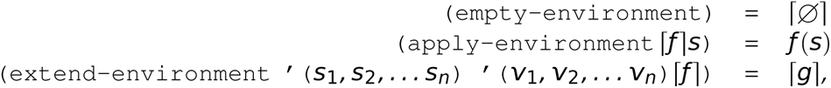
9.8 Case Study: Environments (3 of 4)
Consider an interface specification of an environment, where formally an environment expressed in the mathematical form
is a mapping (or a set of pairs) from the domain—the finite set of Scheme symbols—to the range—the set of all Scheme values:
where g(s’) = v_{i} if s’ = s_{i} for some i, 1 ≼ i ≼ n, and f(s’) otherwise;
⎡v ⎤ means “the representation of data v.”

Slide 41
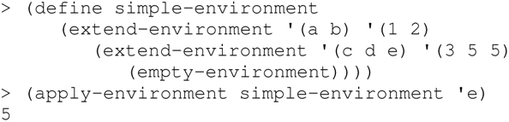
9.8 Case Study: Environments (4 of 4)
The environment {(a, 4), (b, 2), (c, 3), (x, 5)} may be constructed and accessed with the following client code:
Constructors create: empty-environment and extend-environment
Observers extract: apply-environment

Slide 42
9.8.1 Choices of Representation
We consider the following representations for an environment:
Data structure representation (e.g., lists)
Abstract-syntax representation (ASR)
Closure representation (CLS)

Slide 43
9.8.2 Closure Representation in Scheme (1 of 2)
Often the set of values of a data type can be advantageously represented as a set of functions, particularly when the abstract data type has multiple constructors but only a single observer.
Moreover, languages with first-class functions facilitate use of a closure representation.
Representing a data structure as a function—here, a closure—is a non-intuitive use of functions, because we do not typically think of data as code.
How can we represent an environment (which we think of as a data structure) as a function?
The most natural closure representation for the environment is a Scheme closure that accepts a symbol and returns its associated value.

Slide 44
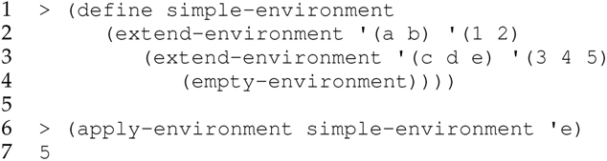
9.8.2 Closure Representation in Scheme (2 of 2)
Getting acclimated to the reality that the data structure is a function can be a cognitive challenge.
Step through the evaluation of the following application code:

Slide 45
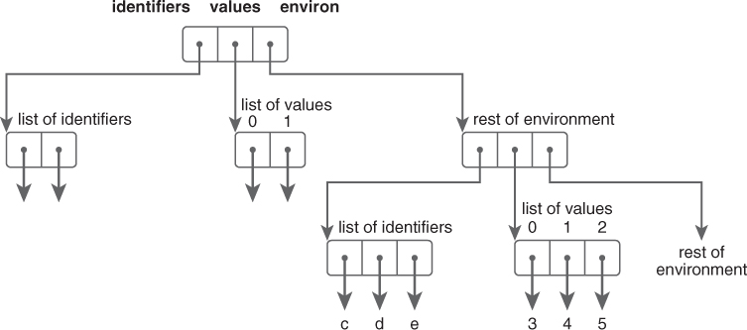
Figure 9.3 An Abstract-Syntax Representation of a Named Environment in Python

Slide 46
Outline
9.1 Chapter Objectives
9.2 Aggregate Data Types
9.3 Inductive Data Types
9.4 Variant Records
9.5 Abstract Syntax
9.6 Abstract-Syntax Tree for Camille
9.7 Data Abstraction
9.8 Case Study: Environments
9.9 ML and Haskell: Summaries, Comparison, Applications, and Analysis
9.10 Thematic Takeaways

Slide 47
9.9.3 Comparison of ML and Haskell
Haskell = ML + Lazy Evaluation - Side Effects
ML = Lisp - Homoiconicity + Safe Type System
Haskell = Lisp - Homoiconicity + Safe Type System
- Side Effects + Lazy Evaluation

Slide 48
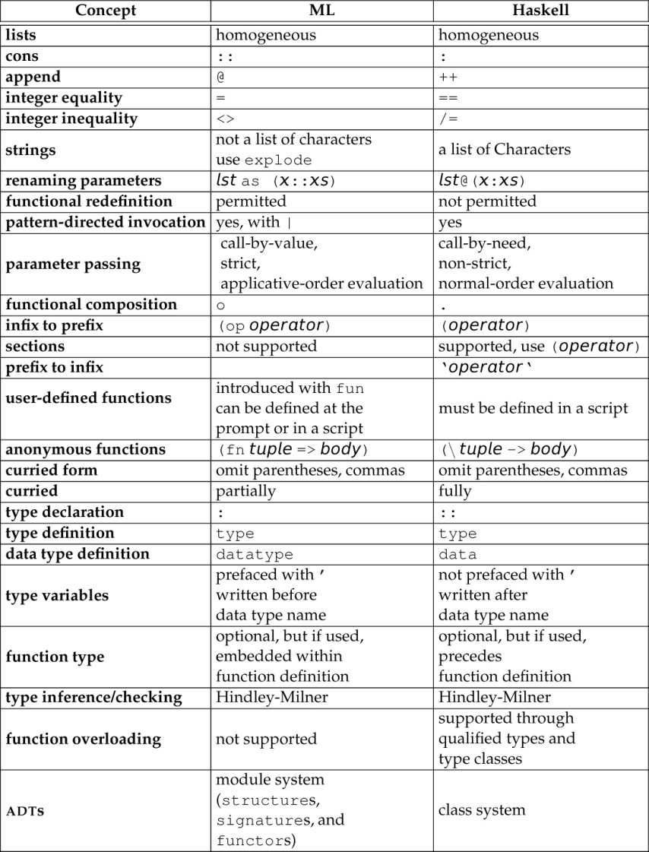
Table 9.7 Comparison of the Main Concepts and Features of ML and Haskell

Slide 49
Outline
9.1 Chapter Objectives
9.2 Aggregate Data Types
9.3 Inductive Data Types
9.4 Variant Records
9.5 Abstract Syntax
9.6 Abstract-Syntax Tree for Camille
9.7 Data Abstraction
9.8 Case Study: Environments
9.9 ML and Haskell: Summaries, Comparison, Applications, and Analysis
9.10 Thematic Takeaways

Slide 50
9.10 Thematic Takeaways (1 of 2)
A goal of a type system is to support data abstraction and, in particular, the definition of abstract data types that have the properties and behavior of primitive types.
An inductive variant record data type—a union of records—is particular useful for representing an abstract-syntax tree of a computer program.
Data types and the functions that manipulate them are natural reflections of each other.
The conception and use of an abstract data type data structure are distributed among an implementation-neutral interface, an implementation containing function definitions, and an application containing invocations to functions in the implementation.

Slide 51
9.10 Thematic Takeaways (2 of 2)
The underlying representation/implementation of an abstract data type can change without breaking the application code as long as the contractual signature of each function declaration in the interface remains unchanged.
In this way, the implementation hidden from the application.
A variety of representation strategies for data structures are possible, including list, abstract syntax, and closure representations.
Well-defined data structures as abstract data types are an essential ingredient in the implementation of a programming language (e.g., interpreters and compilers).
A programming language with an expressive type system is indispensable for the construction of efficacious and efficient data structures.

